Slide 1
APRIL MEETING
TOURNAMENT RUGBY

Slide 2
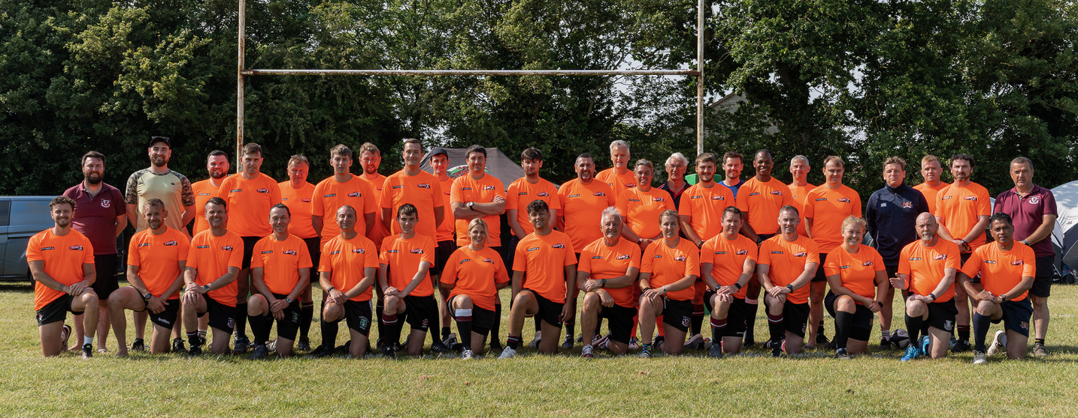
FRIENDSHIP
02
You work with people you maybe a different level
01
You are not on your own!

Slide 3
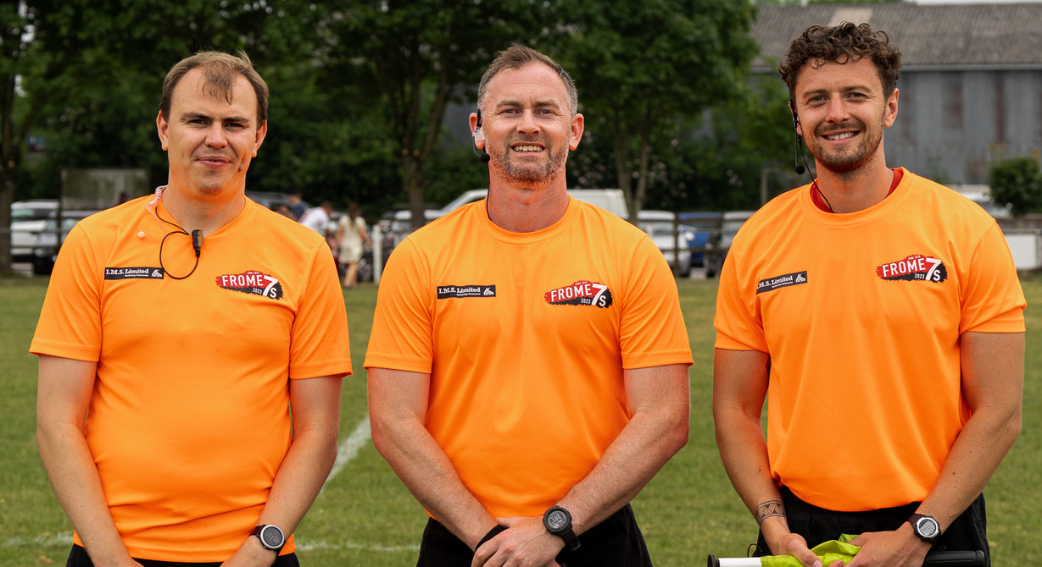
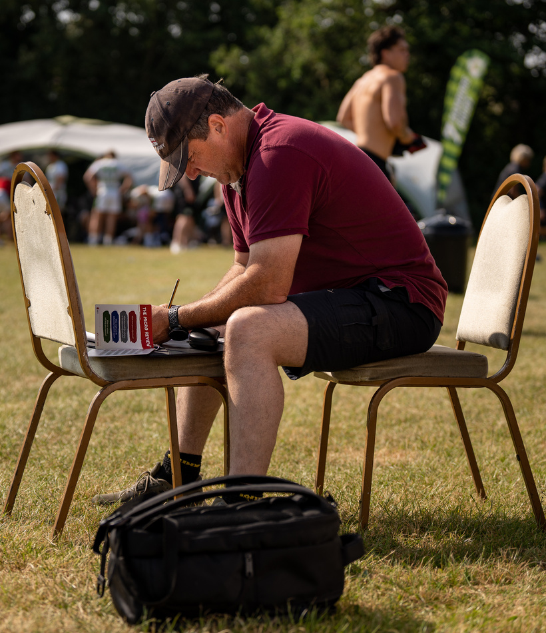
03
Support is always available
04
Watch & learn from the societies best!

Slide 4
UNDERSTAND THE DAY
01
05
What have I been appointed to?
Do I know where I am going?
02
06
Are there any law changes to the norm?
Is there anyone I can share a lift with?
03
07
Is there anything I need to make the referee coordinator aware of?
What kit do I need?
04
08
How long will I be there?
What are my main aims of the day?

Slide 5
ALL TOURNAMENTS
01
Make sure you use your downtime as best as possible
05
Listen to what tends are happening, work together to combat it
02
Use each game to develop 1 thing - never stop learning
06
Allow for brief conversations after games, never get into dialogue
03
Remember you are likely to see the same team more than once
07
Make sure you know where you are going next, we keep the event on time
04
Talk to the fellow refereeing team to help with issues across the day
08
Understand what the organisers are trying to achieve from the event

Slide 6
7s BASICS
01
If the ball is taken into in-goal by the attacking side & is held up, what is your decision?
05
How long is each half in the game of 7s?
02
If the kick-off does not reach the 10m line, what is your decision?
06
How long does a player have to take a conversation after a try?
03
How many players make up the scrum? Can the props bind onto each other?
07
How is a penalty at goal taken?
04
If there is a ruck in their own half & they kick the ball out into the opposition 22 on the bounce, who’s line-out is it?
08
If the ball is kicked into the defending teams in-goal & is grounded by a defend, what is your decision?

Slide 7
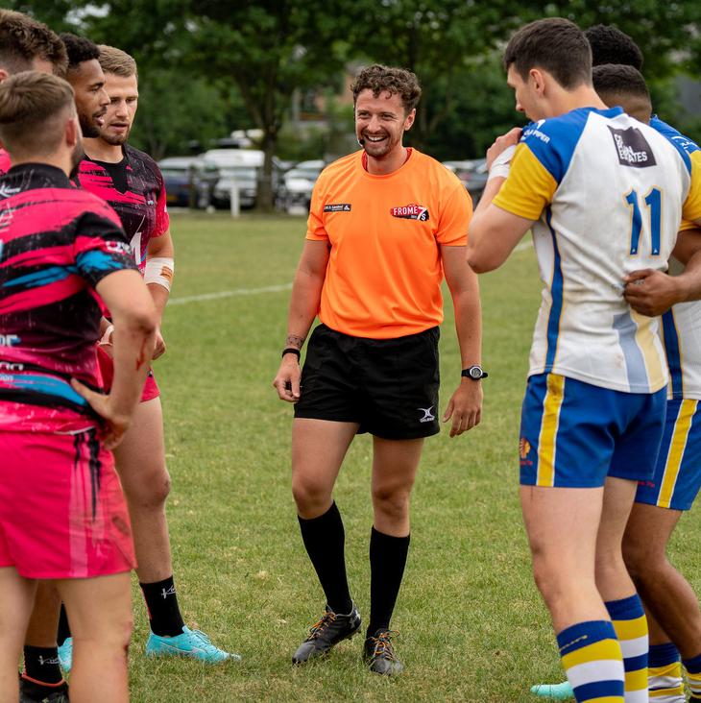
RESTARTS
A quick way to get the game going again - do not overthink!
Kick Off
Scrum
Line Out
Why is this classed as the 1st restart in 7s?
3 players
Binding
Who wants what?
Expect the quick throw
Make sure we have a player 2x2
Who wants what?

Slide 8
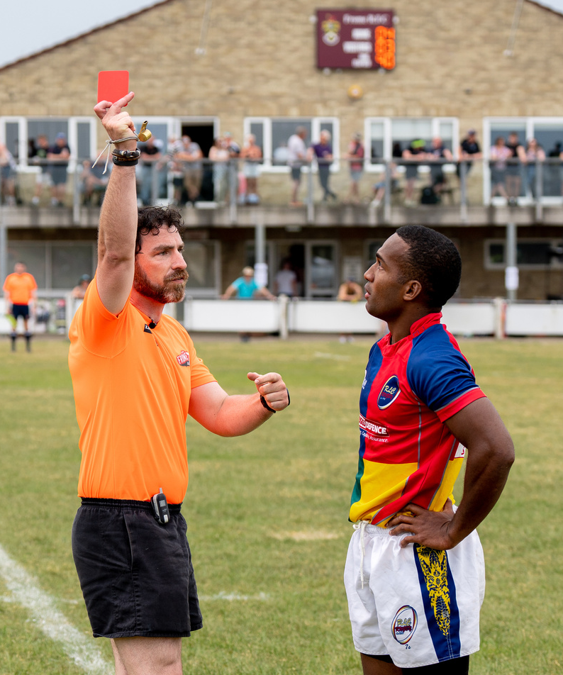
PENALTIES
How quickly are we looking to penalise?
Is advantage needed?
Where are we on the pitch?
Do we need anything more?

Slide 9
THE H

Slide 10
UPCOMING TOURNAMENTS
26th April
24th / 25th May
Old Reds Junior 10s
Beach Tag Rugby - Exmouth
27th April
Revel Rugby Junior Tour Event @ North Petherton RFC
3rd May
14th / 15th June
Burleigh Travel Junior Tour Event @ Ivybridge RFC
4th May
Beach Tag Rugby - Jersey
Mendip 7s Junior @ Winscombe RFC
28th June
M5 7s @ Avonmouth RFC (Supporting Bristol)
12th / 13th July
5th July
North Dorset 7s (Supporting the Club)
Beach Tag Rugby - Weymouth
26th July
Thrive 7s @ Royal Wootton Bassett RFC
2nd Aug
16th / 17th August
Bath Combination 7s @ Midsomer Norton RFC
Beach Tag Rugby – Weston Super Mare
30th Aug
Kingswood School Pre-Season Day
Yeovil 10s

