Slide 1
Scope
Differences
Roles
Pre Game Admin
Pre Game Duties
Downtime
Questions

Slide 2
Differences
Bigger Match Official Team
Share the burden of responsibility
Unfamiliar teams
Papa Johns – may be out of area
Culmination of Competition for players
Form book can go out the window
Bigger crowd
With key officials and sponsors
Key Decisions matter more
Close game does not need to be won / lost on a wrong/controversial decision
Presentations at the end
Tension is palpable
All of which leads to:

Slide 3
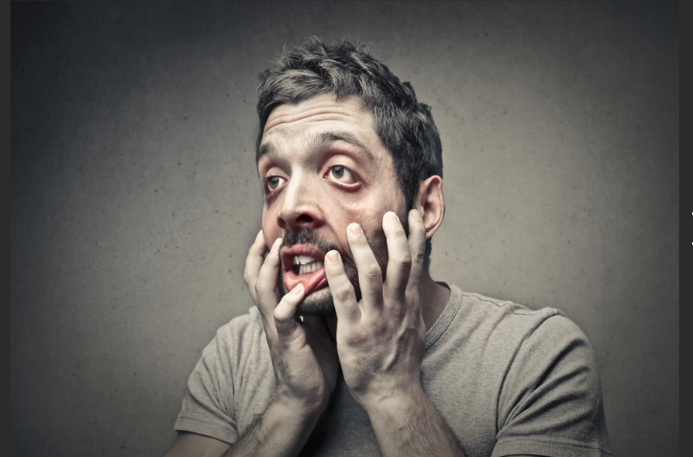
PRESSURE

Slide 4
Roles
Referee
AR1
AR 2
No. 4
No. 5
Timekeeper
Performance Reviewer
Coach

Slide 5
Pre-Game Admin
Referee’s Responsibilities:
Set up a WhatsApp Group for the match officials (and advisors).
Initial post could be to send written AR brief.
Confirm Comms availability.
Confirm Competition Regs and send to group.
Liaise with organisers and post details of match/meeting time etc.
Travel considerations – attempt to travel together.
Confirm Match Kit/Colours
Assistant Referee Responsibilities:
Acknowledge WhatsApp posts.
Read and understand the written brief.
Normal kit and admin prep.
Inform Ref of kit deficiencies (if any).
Pack Flags.
Ensure you are ready to take over as referee.

Slide 6
Pre-Game Admin
No4/No5 Responsibilities:
Acknowledge WhatsApp posts.
Read and understand the written brief.
Print off Regs
Prepare Match Cards
Use different colours for each team
Number for the amount of interchanges

Slide 7
Game Roles
Referee’s
Lead the whole Match Official Team.
In case of a draw, know the next steps.
Assistant Referee:
No change except do not have to deal with subs and or Technical area.
AR1 is substitute referee
No 4 / No 5:
Issue Subs cards to team if using
Maintain record of subs / interchanges
Police Technical Area vigorously
Check Timekeeper
Good interaction with Technical Areas
Confirm decisions when required
Do Not get into an argument with Teams – Step away.
No 4 may become an AR

Slide 8
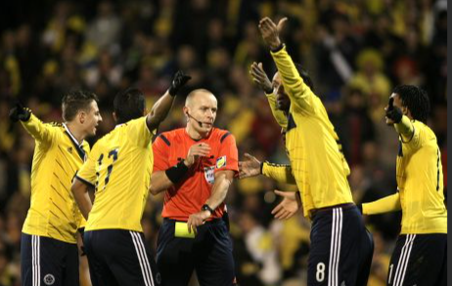
Pressure / Stress

Slide 9
Pressure / Stress
You need stress to perform to the highest level.
Too much stress may lead to:
Lack of Focus / difficulty concentrating
Higher heart rate
Feeling overwhelmed
Irritability
Avoidance
Tiredness
All of the above may lead to:
POOR DECISION MAKING

Slide 10
Dealing with Pressure / Stress
Good Comprehensive pre-match brief to the whole MO Team without PR/Coach listening in.
Good EFFECTIVE communication with players
AR to support with positive comments
Referee to support ARs with positive comments
During breaks in play / downtime feed in areas to watch
Breathing exercises – reduce heart rate
Safe Place – use a good memory
Good Fitness - lowers heart rate naturally
Remain outwardly calm, don’t show others you are stressed.
Enjoy the occasion

Slide 11
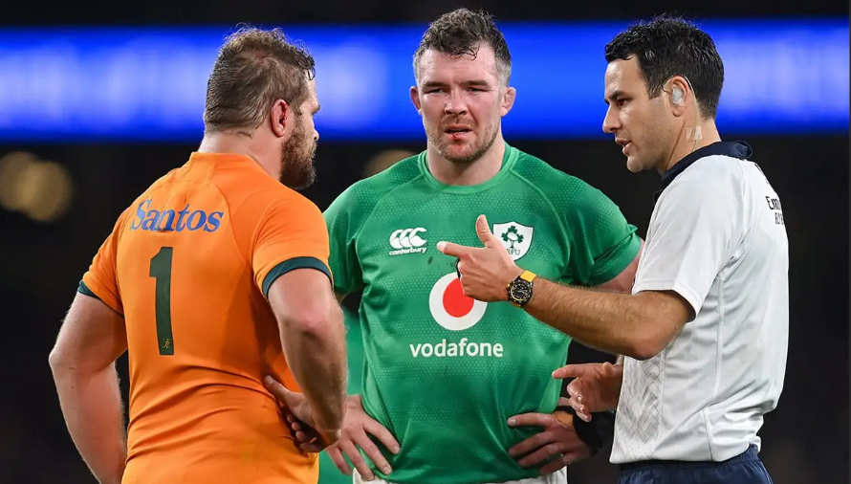
Dealing with Pressure / Stress

Slide 12
Post Game
Normal on pitch niceties.
Closedown Comms
Presentation – referees first
Remain until aal presentations complete
Remove to changing room.
Post Match discussion – Red Cards/Foul Play etc.
Check all equipment is accounted for.
Move to the bar together if possible.

Slide 13
QUESTIONS

